Slide 1
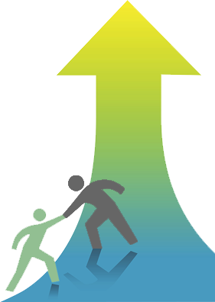
Using Google Apps
For Collaboration
that Promotes UDL

Slide 2
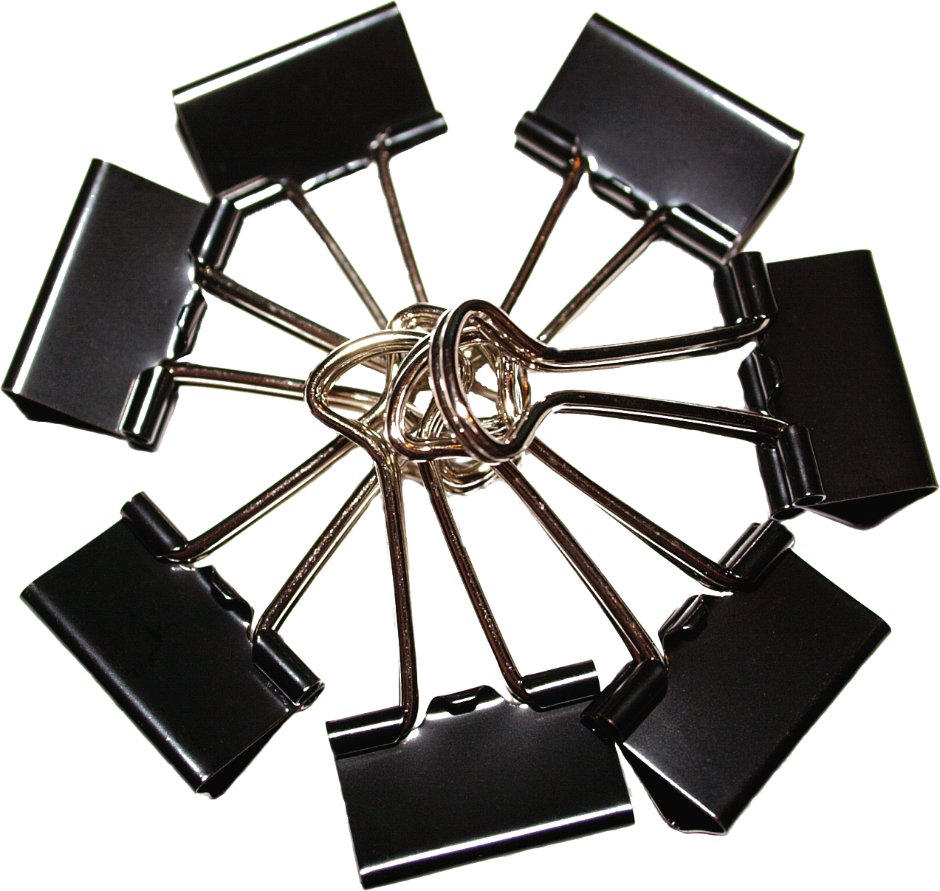
Online Collaboration
Online collaboration requires a virtual workspace.
Helpful workspace features include utilities for communication, content creation, and content sharing or presentation.
Google’s free apps provide key utilities needed in a virtual workspace.

Slide 3
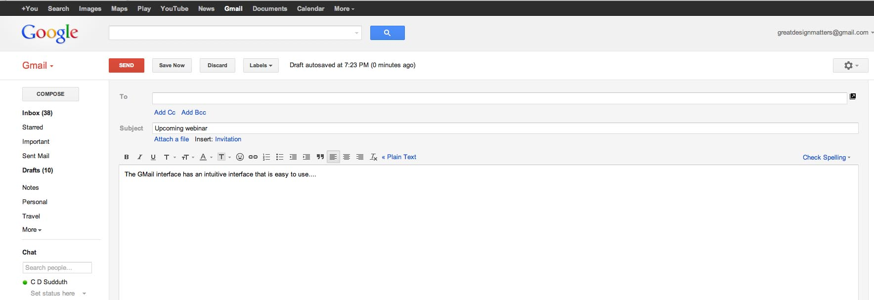
Three Free Apps…
Google Mail

Slide 4
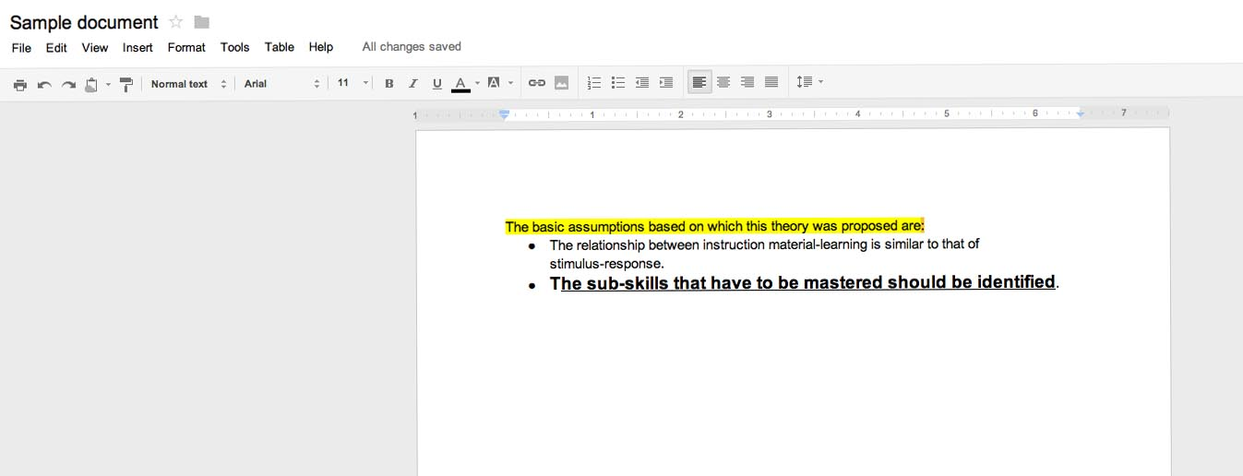
Three Free Apps…
Google Docs

Slide 5
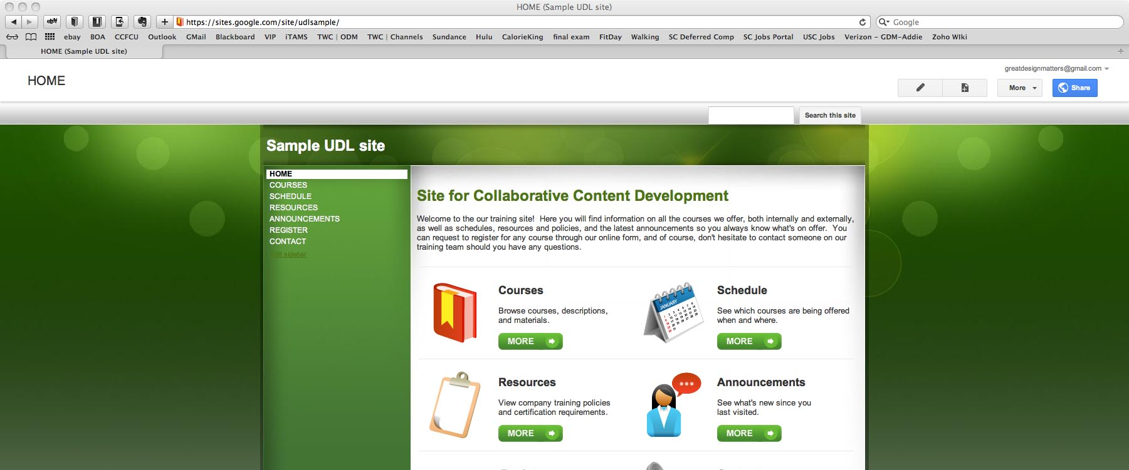
Three Free Apps…
Google Sites

Slide 6
Google Mail
A Google mail (“Gmail”) account is the first step in accessing the free apps.
Is a full-featured e-mail program with a video chat feature and more than 7 GB of storage.

Slide 7
Google Docs
Google Docs provides an online workspace in which text documents, spreadsheets, drawings, and presentations can be developed or edited collaboratively in real time.
It includes an optional text chat panel located within the workspace.

Slide 8
Google Docs
Google Docs recognizes a variety of file formats that can be uploaded and either shared in native format or converted for online editing.
Files can be private or made public for sharing via embed code.

Slide 9
Google Sites
Templates make sites and wikis easy to create and share.
Sites can be shared with collaborators only or made visible to all.
HTML can be modified for accessibility.

Slide 10
Why these three apps?
These three are just some of many free apps available from Google.
These were selected because together they offer much of what is needed to build a free, collaborative workspace.

Slide 11
What is UDL and how can these Google apps be used to promote it

Slide 12
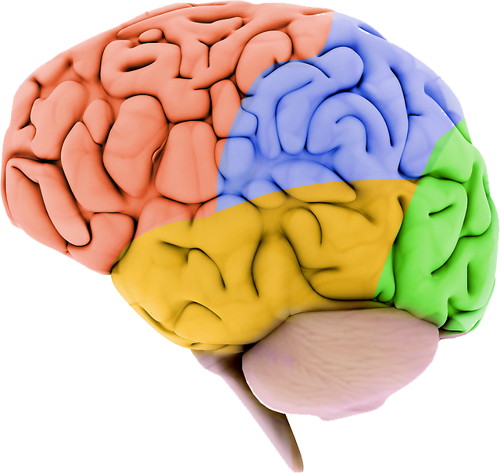
Universal Design for Learning (UDL)
UDL is a set of principles for curriculum development that give all individuals equal opportunities to learn.
Recognizes the three primary brain networks involved in learning: Recognition, Strategic, and Affective

Slide 13
3 Primary Principles Guide UDL
Provide multiple means of representation. (How information is presented)
Provide multiple means of action. (What learners are asked to do)
Provide multiple means of engagement.
(Getting and keeping learners interested)

Slide 14
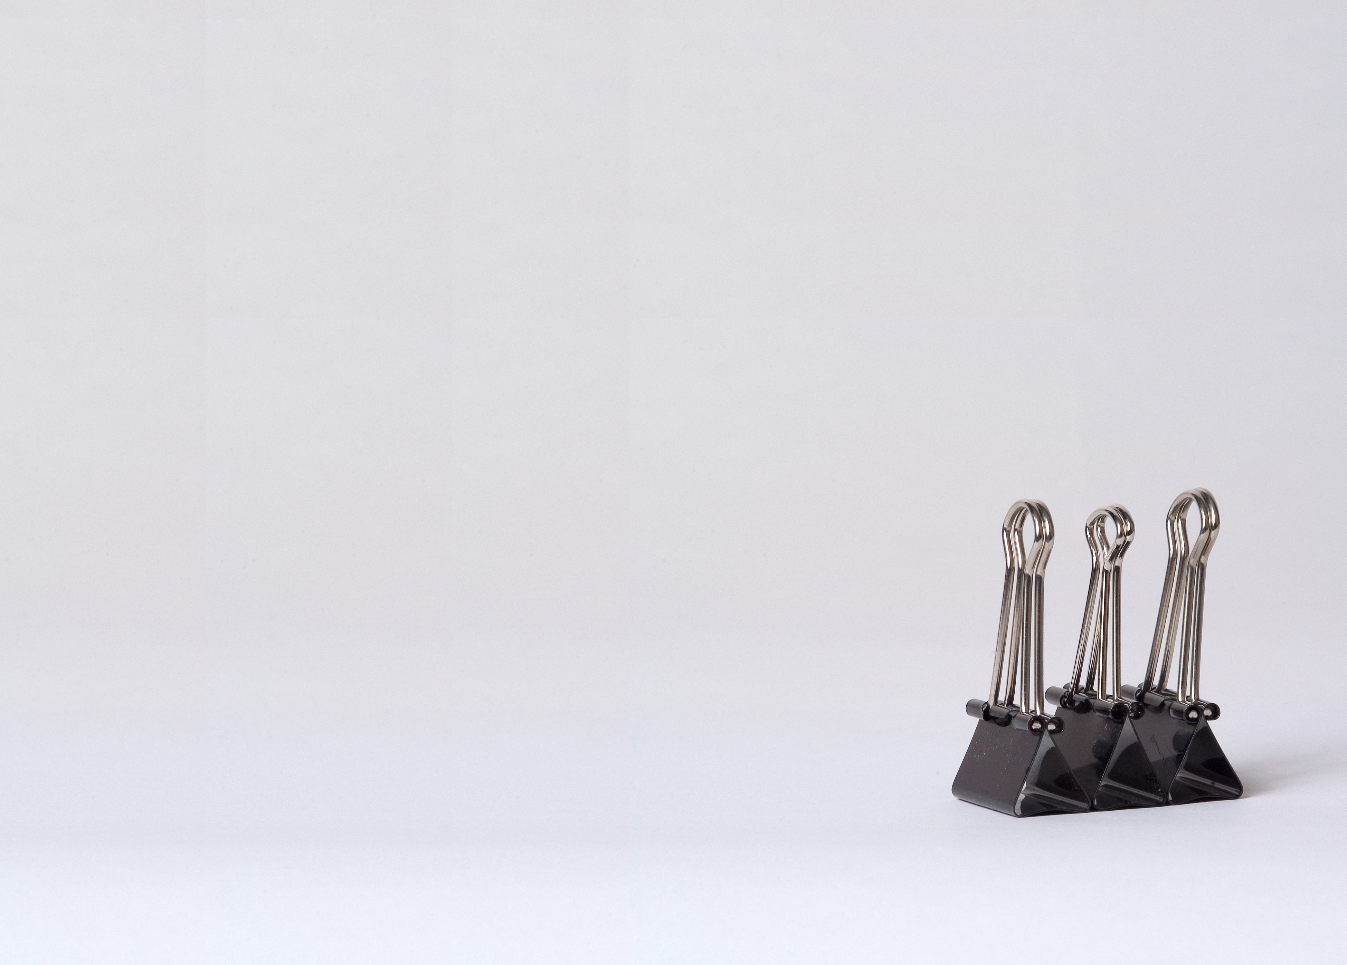
How Google Apps promote the 3 principles of UDL…
“Provide multiple means of representation.”
Google Apps supports the sharing of information in a variety of formats.
Information can be shared as text, diagrams, or as embedded web media.

Slide 15
How Google Apps promote the 3 principles of UDL…
“Provide multiple means of action.”
Using Google Apps, someone can participate
directly through content creation or revision, or in a text or video chat.
Users can also create and participate in Google-based, embedded surveys.

Slide 16
How Google Apps promote the 3 principles of UDL…
“Provide multiple means of engagement.”
The wide variety of information formats
and communication options that Google Apps
offers makes it likely that nearly everyone will find something of interest.

Slide 17
Google Apps and Accessibility
UDL considers everyone, including individuals with physical limitations and special needs.
Google Apps’ accessibility features include keyboard shortcuts and screen reader support.
Gmail’s video chat function facilitates communication between individuals who use sign language.

Slide 18
Resources
Google Apps (google.com/apps/index1.html)
For more information about UDL, visit Cast.org (www.cast.org).
Images are from dreamstime.com and bigstockphoto.com.
Developed by greatdesignmatters.
April 2012

